Slide 1

Database Final Project
Alex Reibsane, anna richardson

Slide 2
Introduction
Our project is a database designed for A delivery service based in Charlotte NC.
We designed this database to include expanded information on all users, including their affiliation with the university, role, and contact information.
Each order has a unique id, as does each customer. In the interest of realism, each person has a separate ID from their organization that differs from their customer ID.
Different data is available which is specific to an individual's organization and role. For example, a delivery driver has a hire date, but doesn't have a major or department at the university.

Slide 3
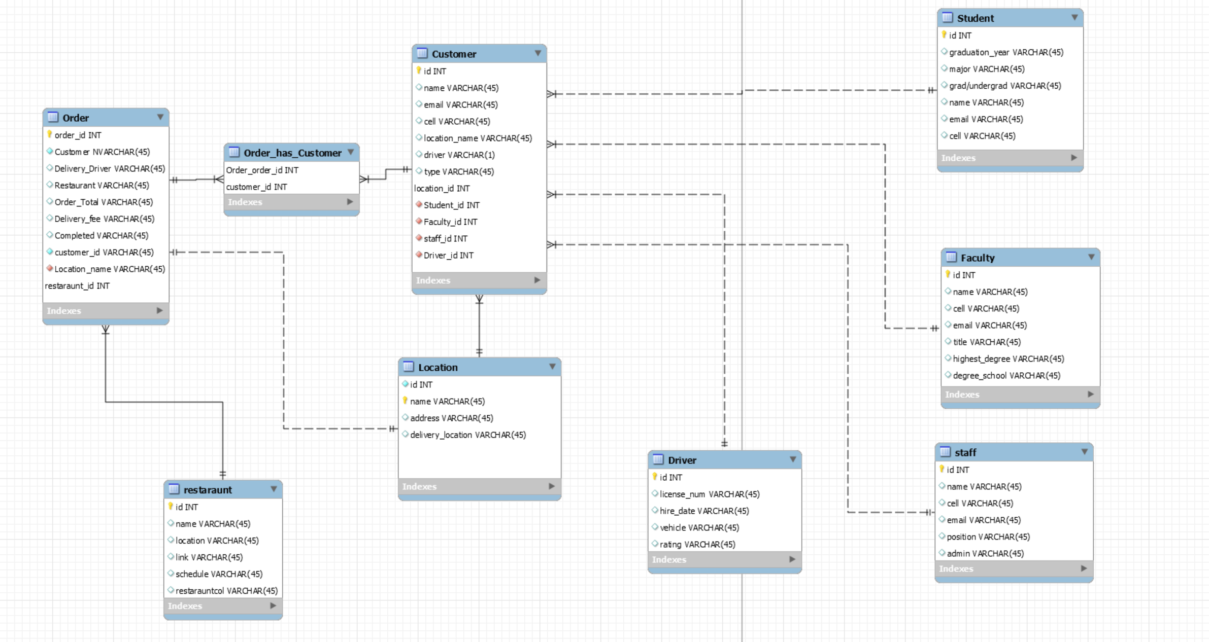
ER Diagram

Slide 4
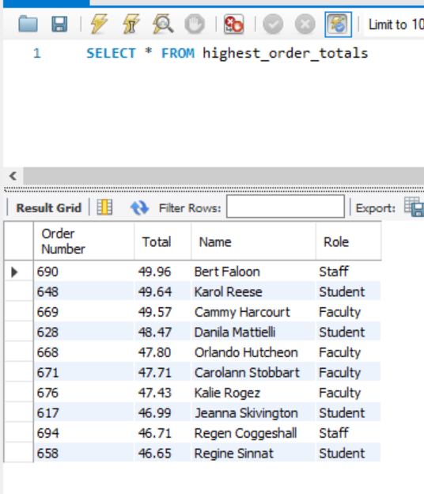
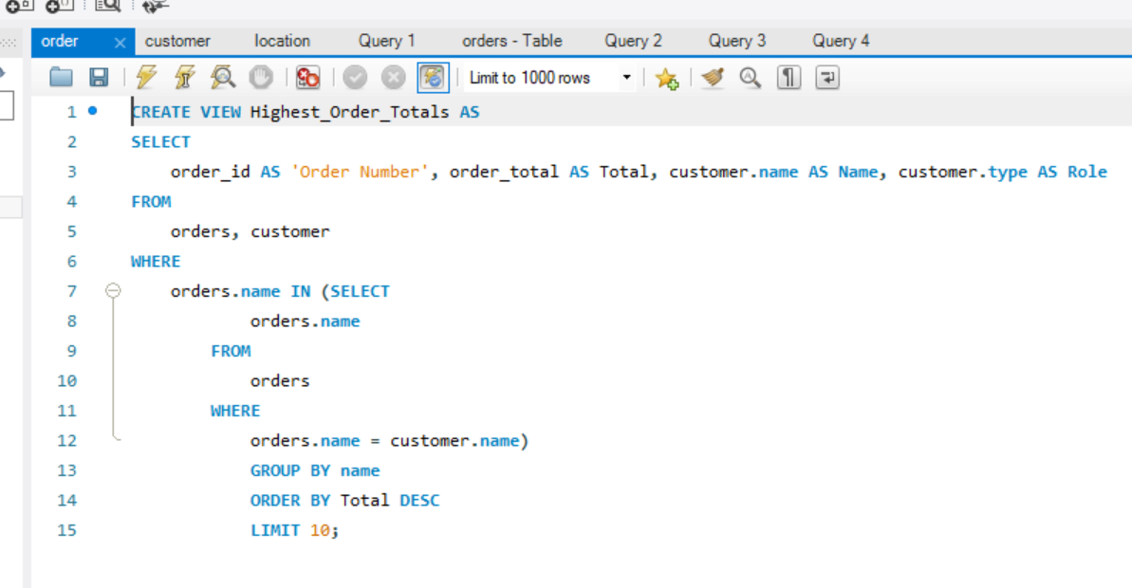
Custom View 1

Slide 5
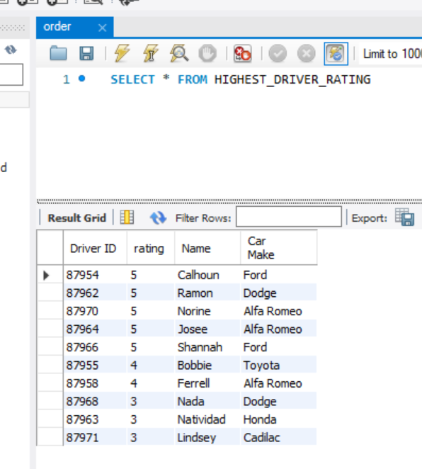
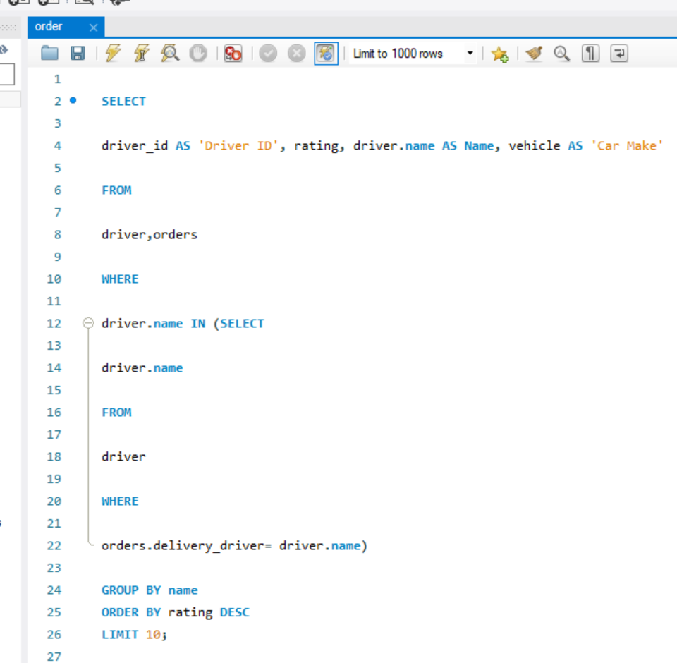
Custom View 2

Slide 6
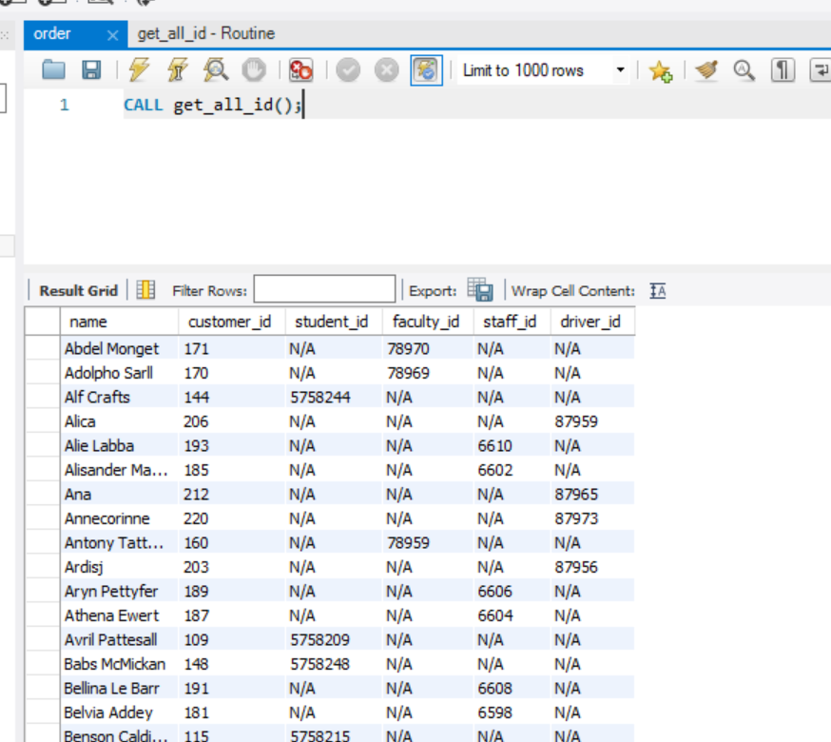
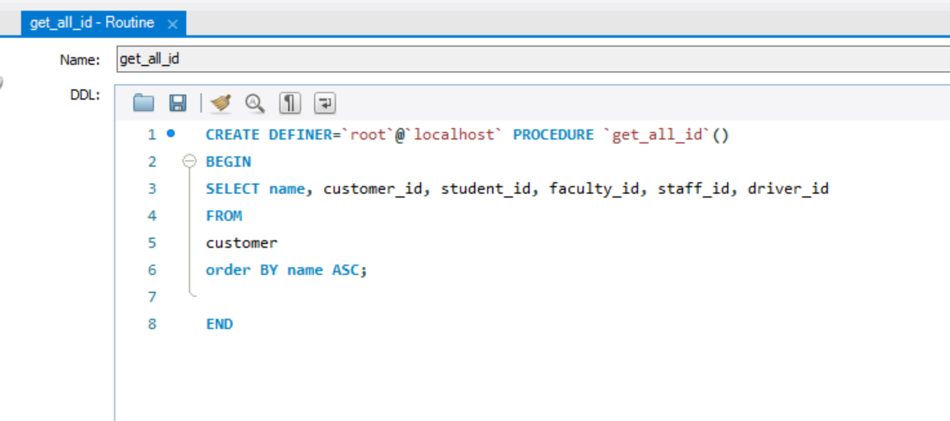
Stored Procedure

